Slide 1

IAMC ANNUAL MEETING, VENICE
14-16 NOVEMBER 2023
Analyzing the trade-offs of sustainable diets on the long-term SDG goals
Clàudia Rodés Bachs (BC3), Jon Sampedro,
Dirk-Jan Van de Ven, Russell Horowitz,
Xin Zhao and Guillermo Pardo
www.iam-compact.eu

Slide 2
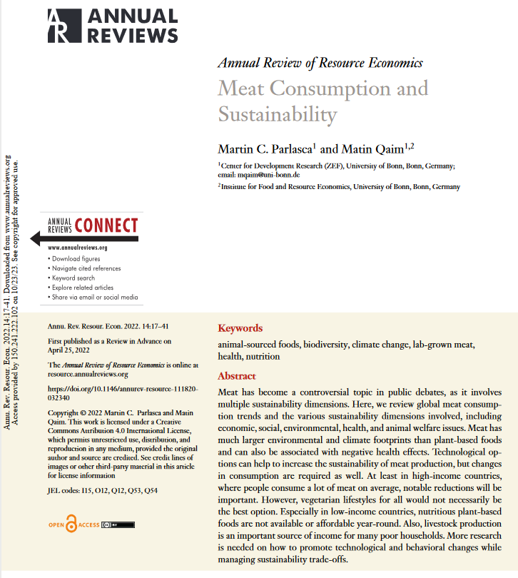
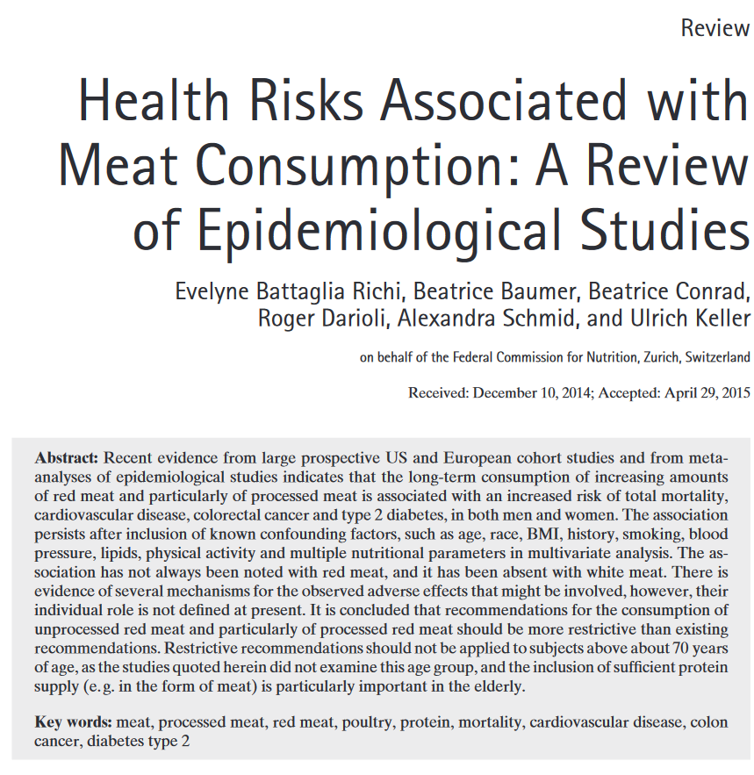
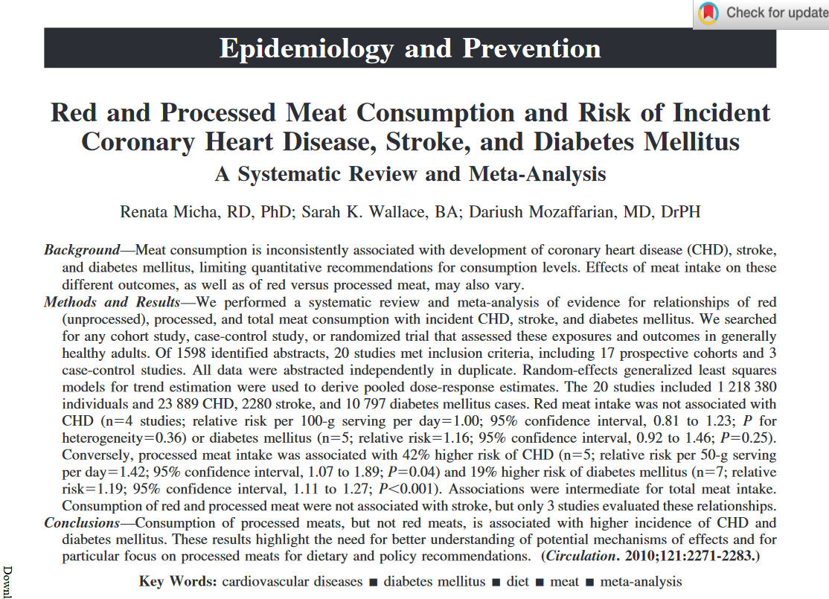
Motivation

Slide 3
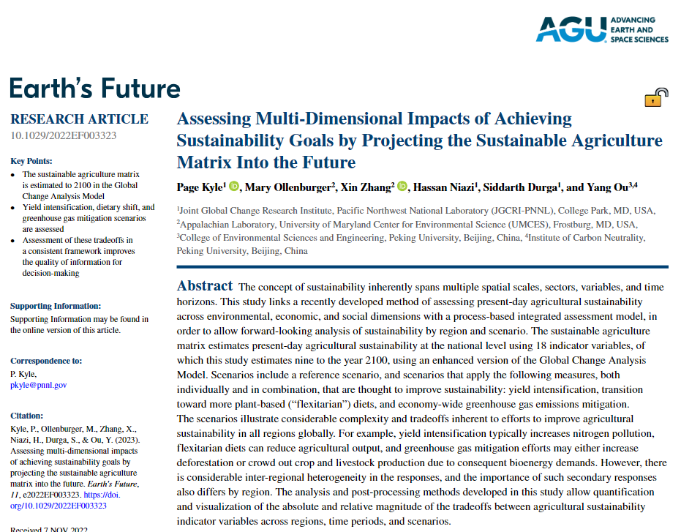
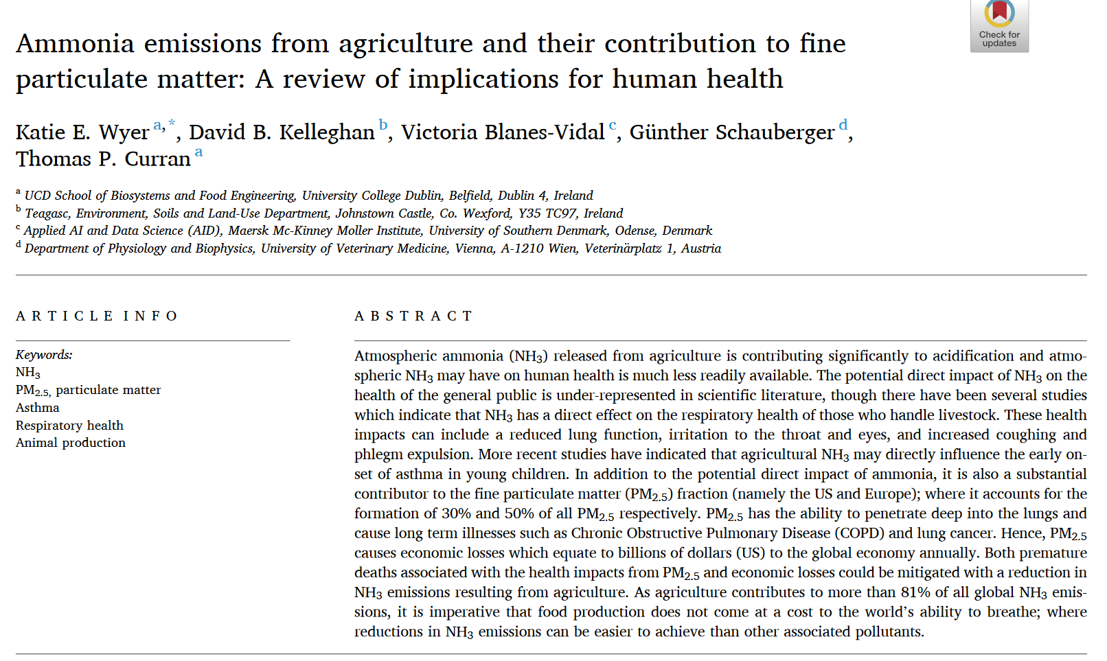
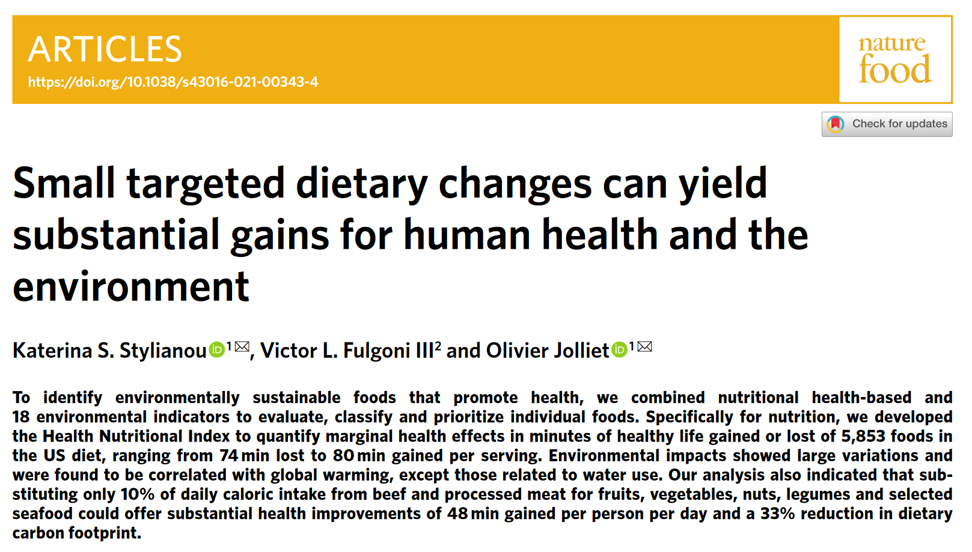
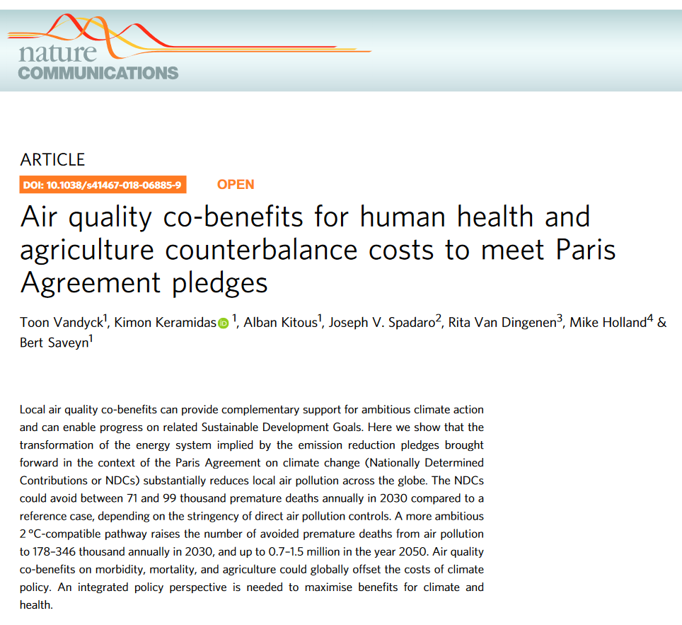
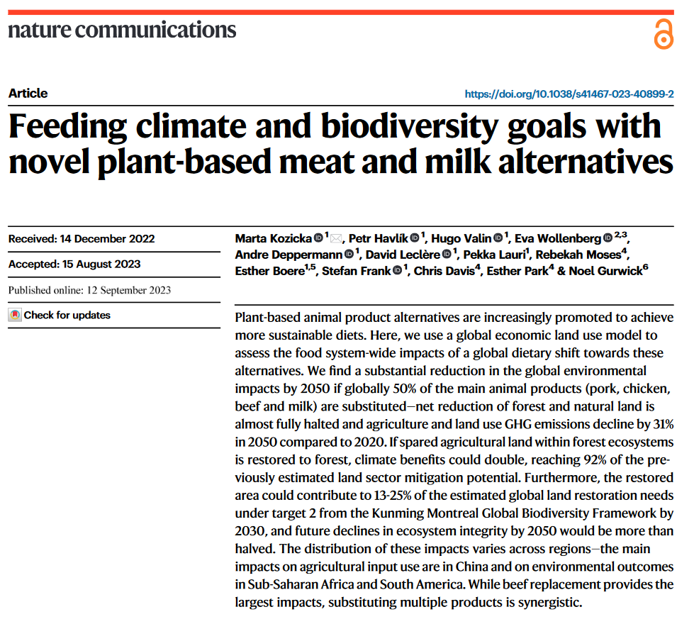
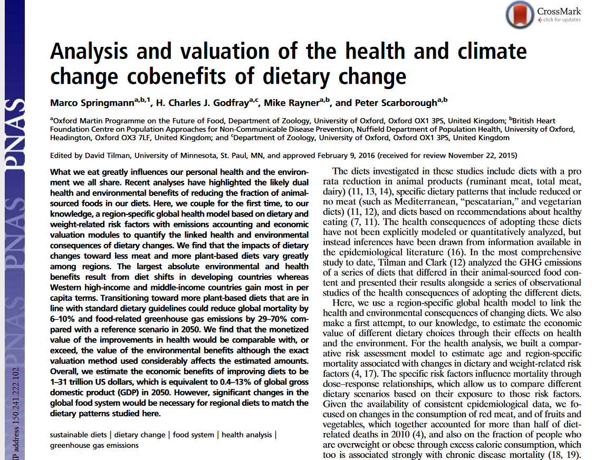
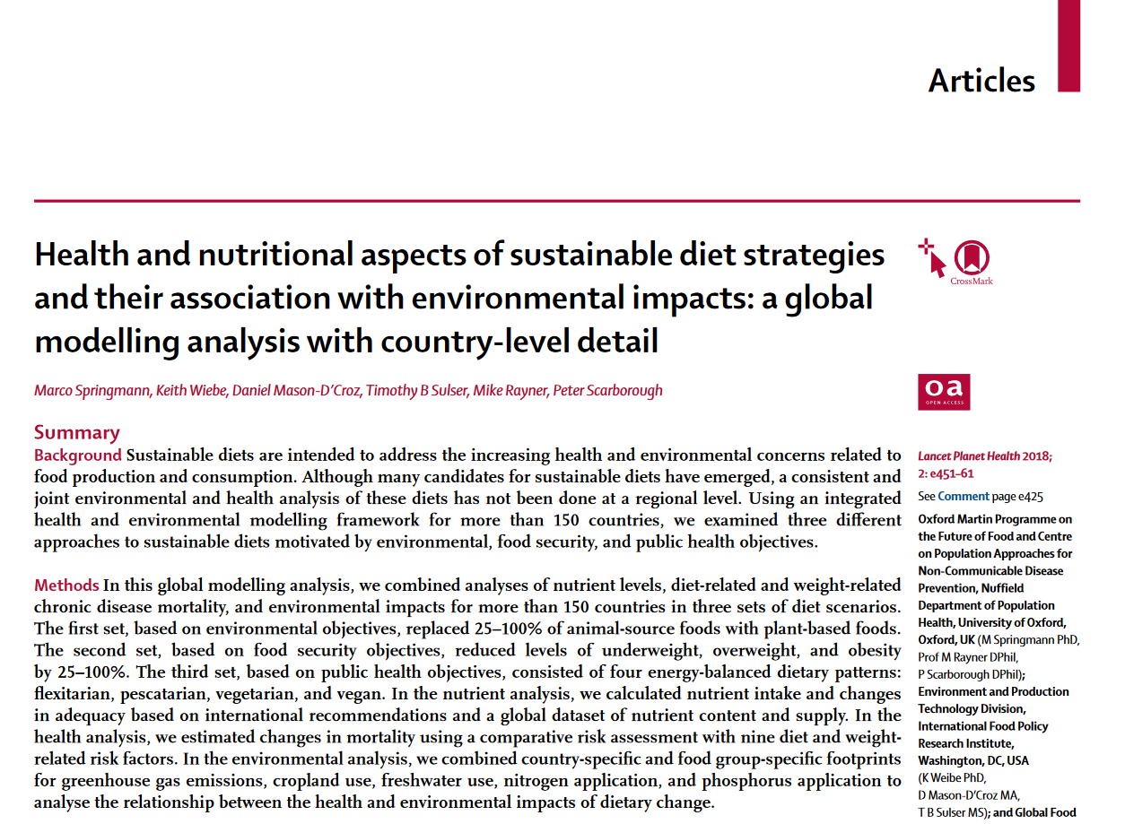
Motivation

Slide 4
Our goals
Q1. | Which will be the system-wide benefits of plant protein based diets?
Q2. | Which will be the system-wide benefits of no-rumiants protein based diets?

Slide 5
Our goals
Q1. | Which will be the system-wide benefits of plant protein based diets?
Q2. | Which will be the system-wide benefits of no-rumiants protein based diets?

Slide 6
Our goals
Q1. | Which will be the system-wide benefits of plant protein based diets?
Q2. | Which will be the system-wide benefits of no-rumiants protein based diets?
SDG2. | Alimentation
 | - Kcal per capita consumption
 | - Macronutrients consumption
 | - Micronutrients consumption

Slide 7
Our goals
Q1. | Which will be the system-wide benefits of plant protein based diets?
Q2. | Which will be the system-wide benefits of no-rumiants protein based diets?
SDG2. | Alimentation
SDG15. | Land Use
 | - Distribution of land use areas
 | - Re-forestation
 | - Fertilizer demand
 | - Crop loss due to air pollution
 | - Carbon stock

Slide 8
Our goals
Q1. | Which will be the system-wide benefits of plant protein based diets?
Q2. | Which will be the system-wide benefits of no-rumiants protein based diets?
SDG2. | Alimentation
SDG15. | Land Use
SDG6. | Water management
 | - Water consumption by crop and livestock
 | - Irrigated and Rainfed water demand

Slide 9
Our goals
Q1. | Which will be the system-wide benefits of plant protein based diets?
Q2. | Which will be the system-wide benefits of no-rumiants protein based diets?
SDG2. | Alimentation
SDG15. | Land Use
SDG6. | Water management
SDG13. | Emissions
 | - GHG emissions
 | - CH4 and N2O agricultural emissions
 | - LUC CO2 emissions

Slide 10
Our goals
Q1. | Which will be the system-wide benefits of plant protein based diets?
Q2. | Which will be the system-wide benefits of no-rumiants protein based diets?
SDG2. | Alimentation
SDG15. | Land Use
SDG6. | Water management
SDG13. | Emissions
SDG3. | Health
 | - Premature deaths due to air pollution
 | - Nutritional health related issues

Slide 11
Our goals
Q1. | Which will be the system-wide benefits of plant protein based diets?
Q2. | Which will be the system-wide benefits of no-rumiants protein based diets?
SDG2. | Alimentation
SDG15. | Land Use
SDG6. | Water management
SDG13. | Emissions
SDG3. | Health
SDG1. | Poverty
 | - Daily food expenditure per capita

Slide 12










Scenarios
Animal protein
Plant
protein
Plant Protein based diets (SPP)
Icons from https://www.flaticon.com/

Slide 13









Scenarios
Rumiants’ protein
Animal protein
Fish
protein
Plant
protein
Plant protein
Monogastrics’ protein
Plant Protein based diets (SPP)
No-Rumiants protein based diets
(SNR)
Icons from https://www.flaticon.com/

Slide 14
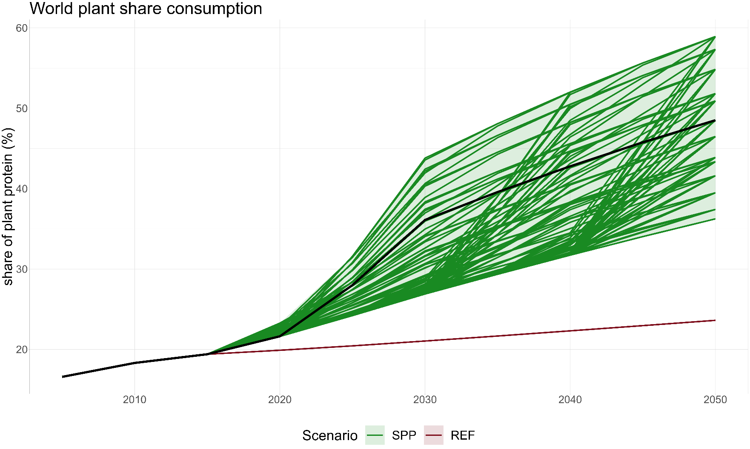
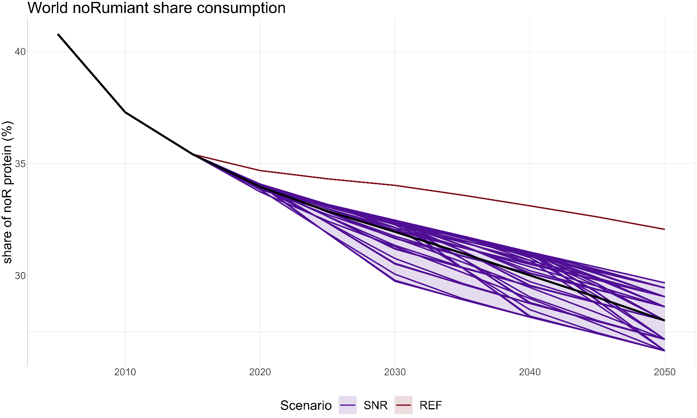
Scenarios
Based on logistic curves
Fig baseline + all runs
world

Slide 15


Scenarios
peak year
final share
Based on logistic curves
slope
Fig baseline + all runs
world
We changed 3 parameters
- final share
- peak year
- slope

Slide 16
Scenarios
peak year
final share
Based on logistic curves
slope
Fig baseline + all runs
world
We changed 3 parameters
- final share
- peak year
- slope
Study the impacts across the scenarios or for the median scenario
median scenario

Slide 17
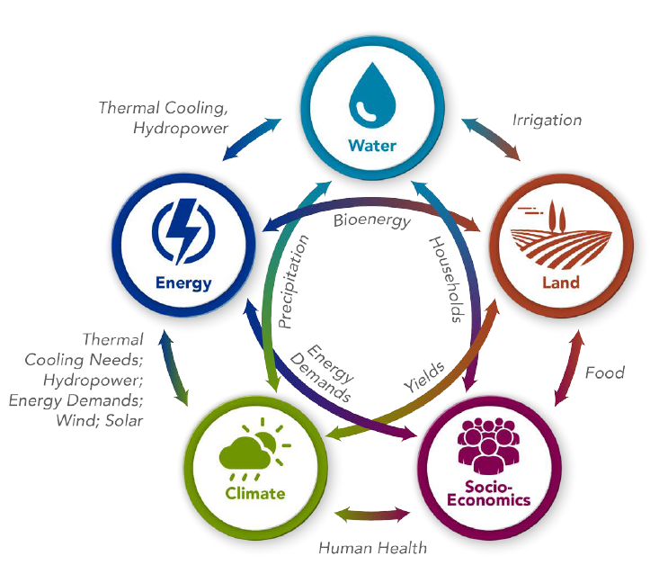
The model: GCAM
GCAM is a well-reputed Integrated Assessment Model
GCAM links 5 systems

Slide 18
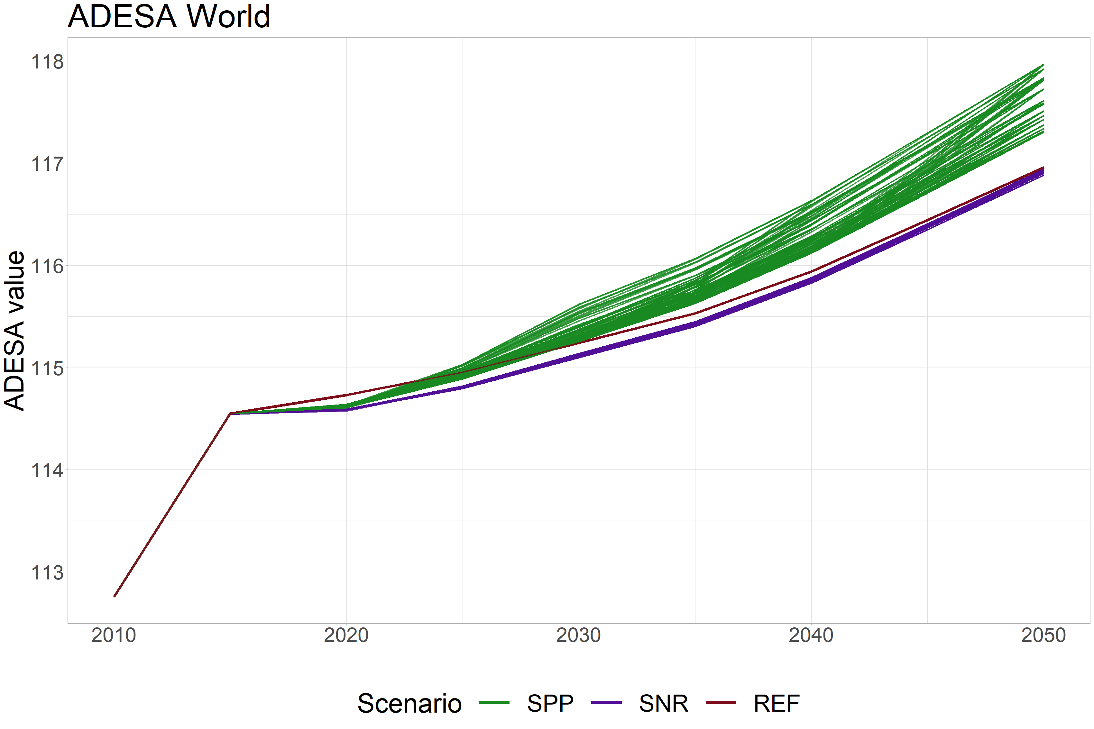
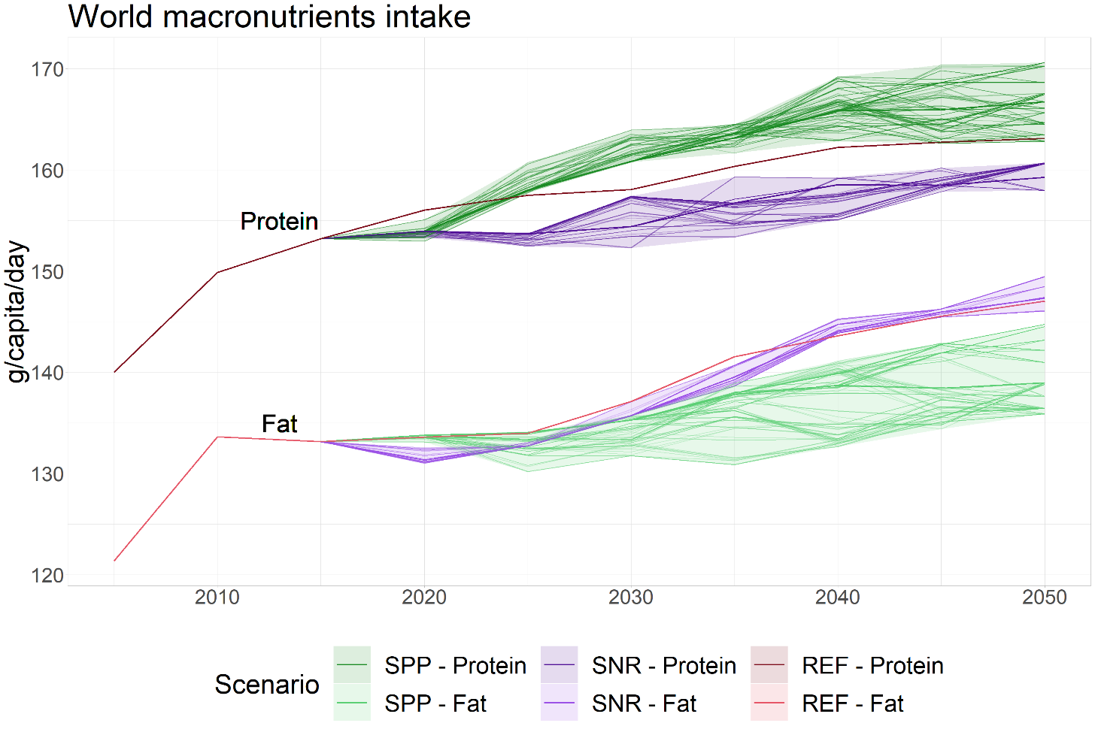
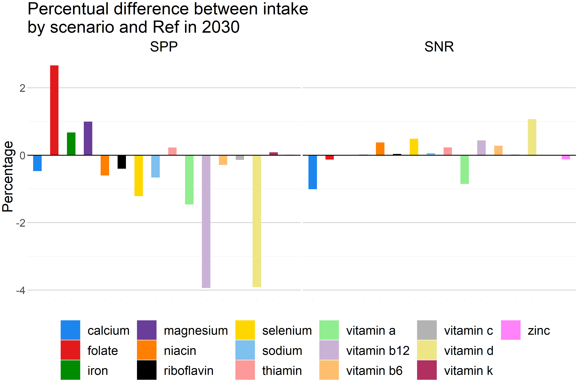
Nutritional point of view
Fig: Kcal intake
Notes:
Average Dietary Energy Supply Adequacy

Slide 19
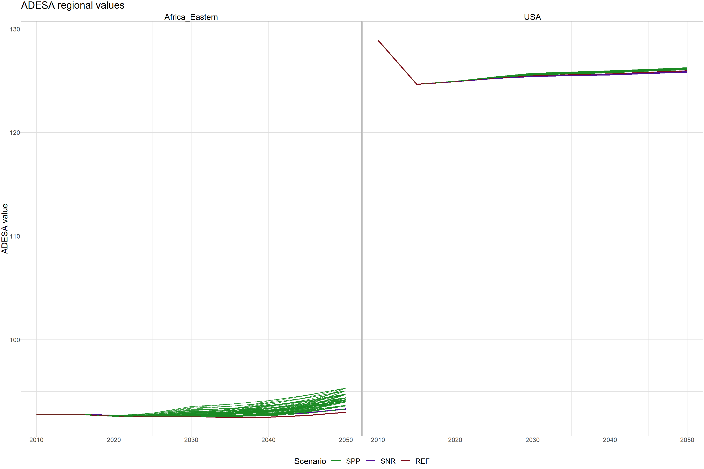
Nutritional point of view
Fig: Kcal intake
Notes:
Average Dietary Energy Supply Adequacy

Slide 20
Nutritional point of view
Fig: Kcal intake
Notes:
Average Dietary Energy Supply Adequacy

Slide 21
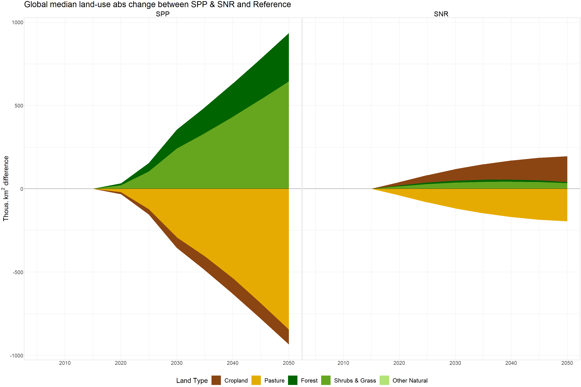
Land types
SPP reduces cropland for feed and pastures for animals
Cropland for feed requires more area tan the cropland for nuts and legumes
Fig: land use world

Slide 22
Land types
SPP reduces cropland for feed and pastures for animals
SNR reduces pastures but increases cropland due to feed purposes
Fig: land use world

Slide 23
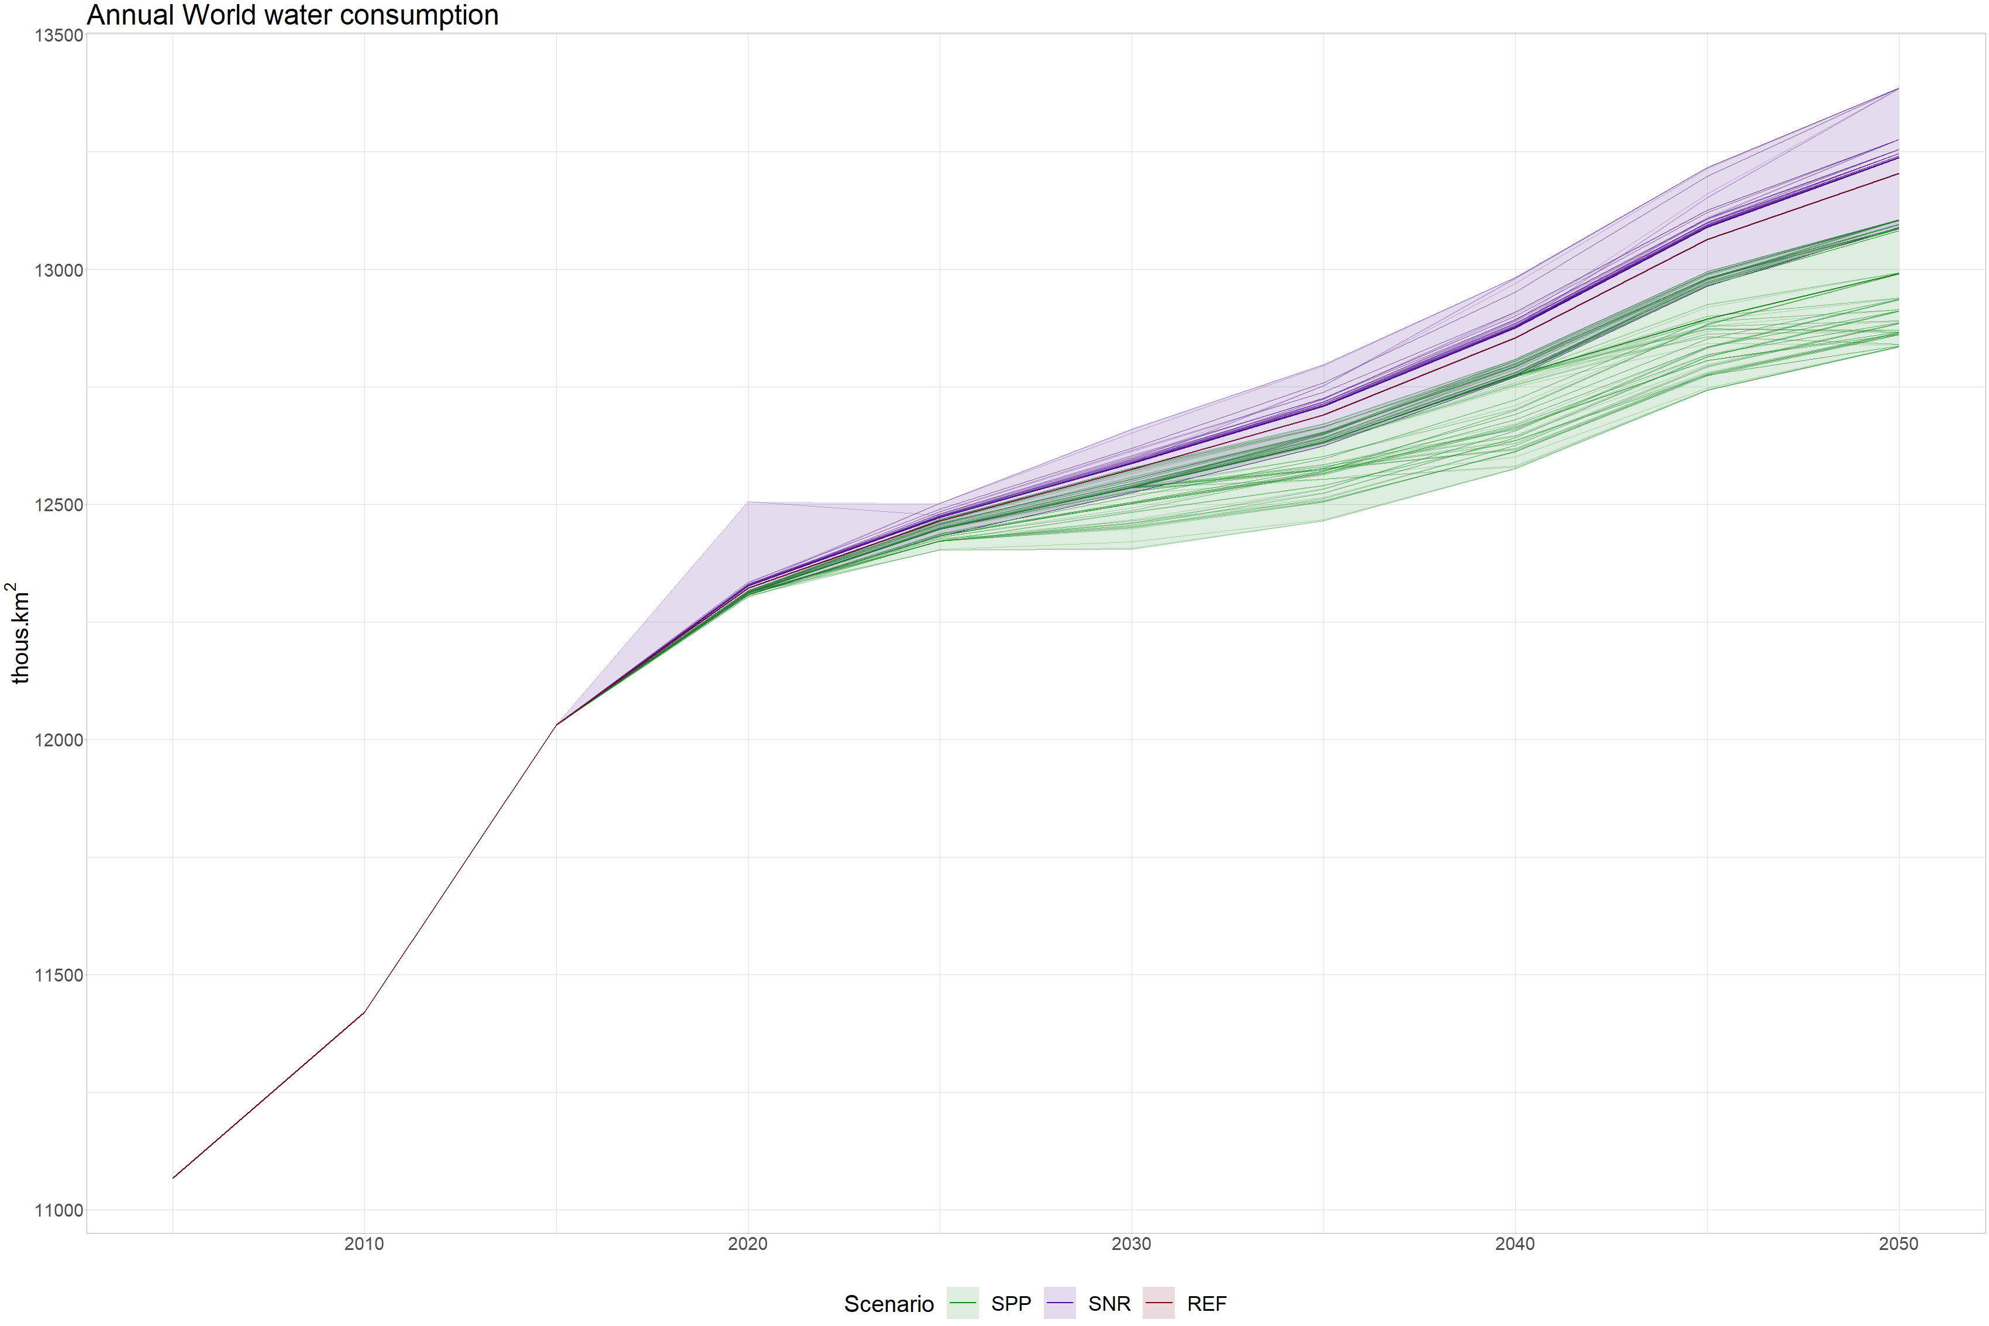
Water
SPP reduced cropland for feed, which is very water-intensive
SNR increased cropland for feed, which makes the water consumption increase
Fig: water consumption

Slide 24
Water
SPP reduced cropland for feed, which is very water-intensive
SNR increased cropland for feed, which makes the water consumption increase

Slide 25
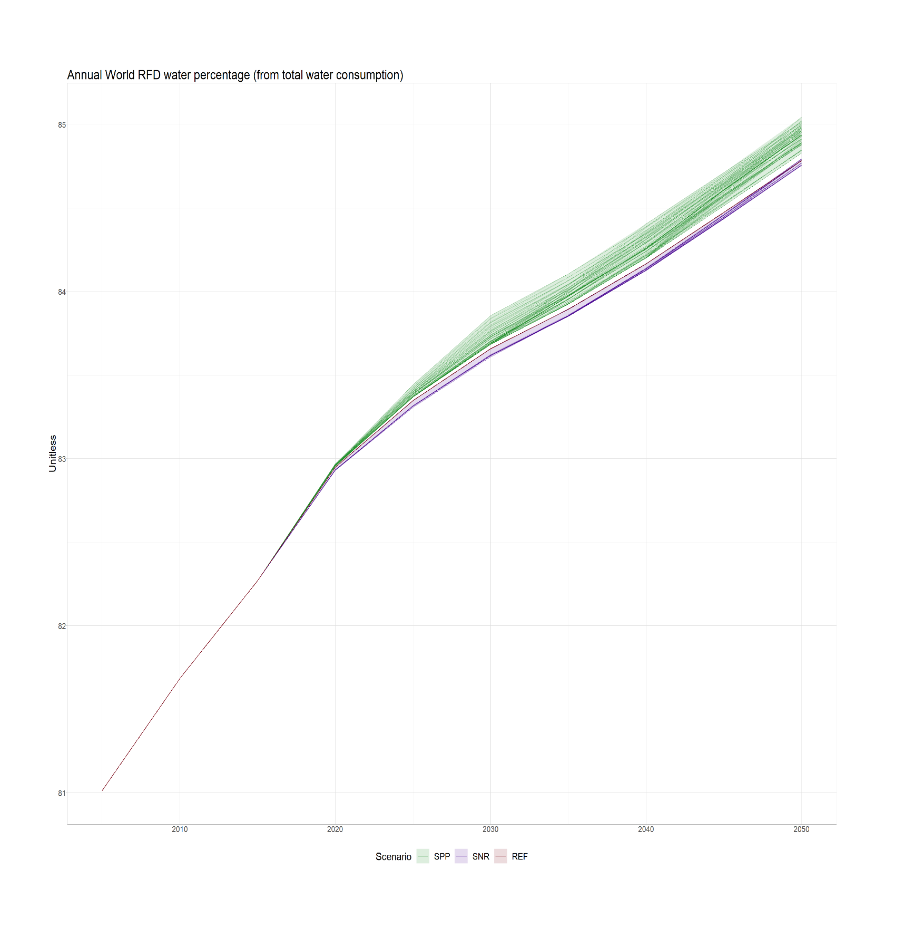
Water
Rainfed water is very sensitive to the dietary scenario
SNR increases both IRR & RFD water
SPP decreses both IRR & RFD water
SPP increases RFD percentual use, and SNR decreases it
Fig: water consumption

Slide 26
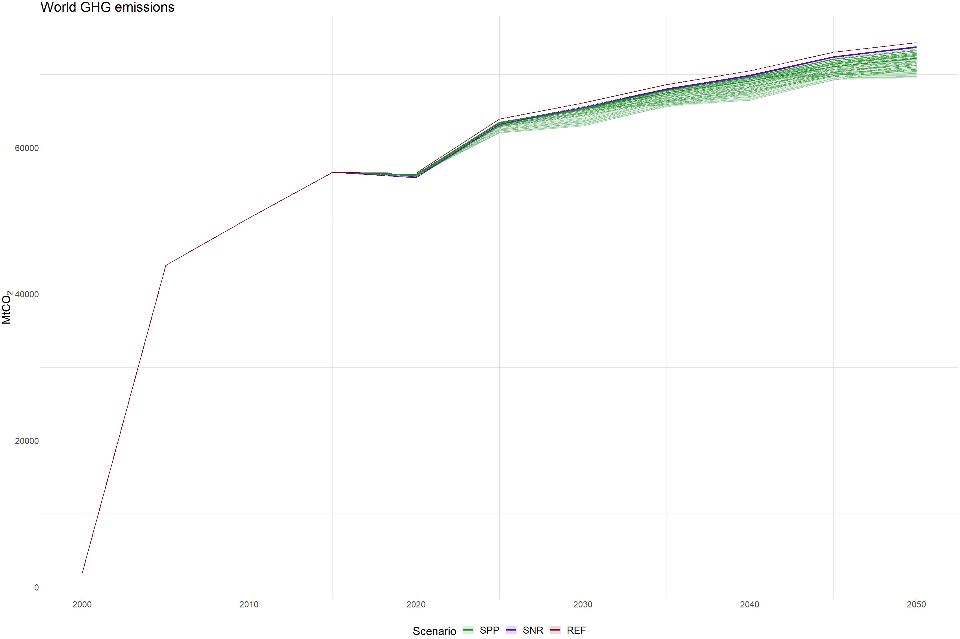
GHG emissions
GHG emissions will reduced, specially following the SPP
Fig: ghg emissions

Slide 27
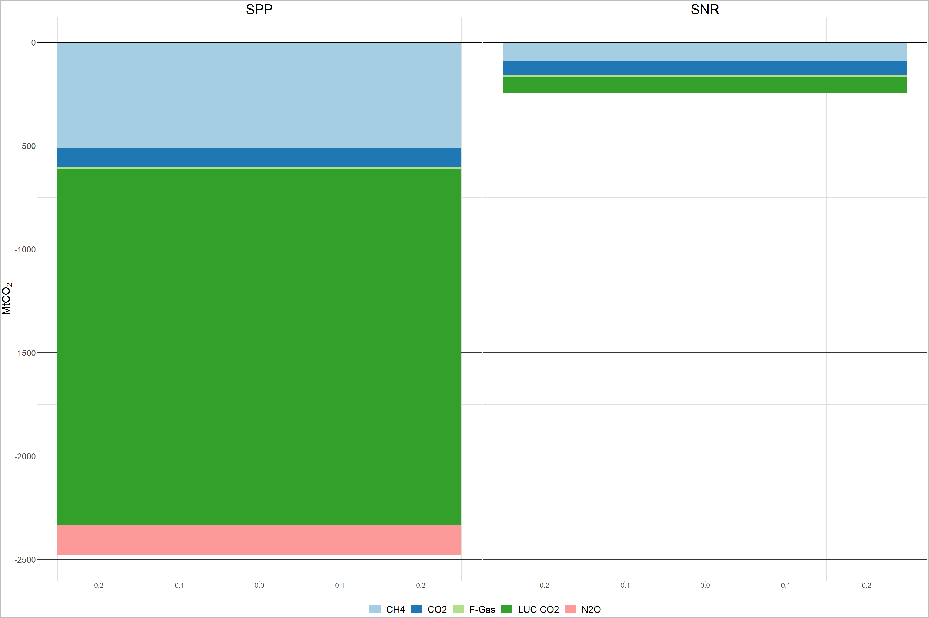
GHG emissions
GHG emissions will reduced, specially following the SPP
SPP would drastically reduce the LUC CO2
Fig: ghg emissions

Slide 28
GHG emissions
GHG emissions will reduced, specially following the SPP
SPP would drastically reduce the LUC CO2
CH4 reduction due to
rumians reduction
Fig: ghg emissions

Slide 29
GHG emissions
GHG emissions will reduced, specially following the SPP
SPP would drastically reduce the LUC CO2
CH4 reduction due to
rumians reduction
Fig: ghg emissions
LUC CO2 reduction due to pasture reduction and reforestation

Slide 30
GHG emissions
GHG emissions will reduced, specially following the SPP
SPP would drastically reduce the LUC CO2
CH4 reduction due to
rumians reduction
Fig: ghg emissions
LUC CO2 reduction due to pasture reduction and reforestation
N2O reduction due to cropland (fertilizers) reduction

Slide 31
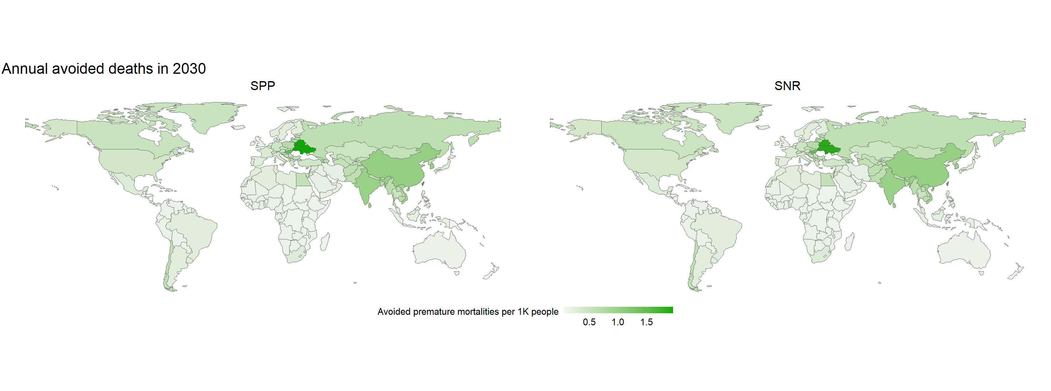
Air pollution health impact
Annual avoided premature mortalities per 1K people
Fig: avoided premature deaths due to AP

Slide 32
Air pollution health impact
Annual avoided premature mortalities per 1K people
Fig: avoided premature deaths due to AP
All regions will avoid premature deaths due to air pollution
There will be reductions from 10% to 90% depending on the country

Slide 33
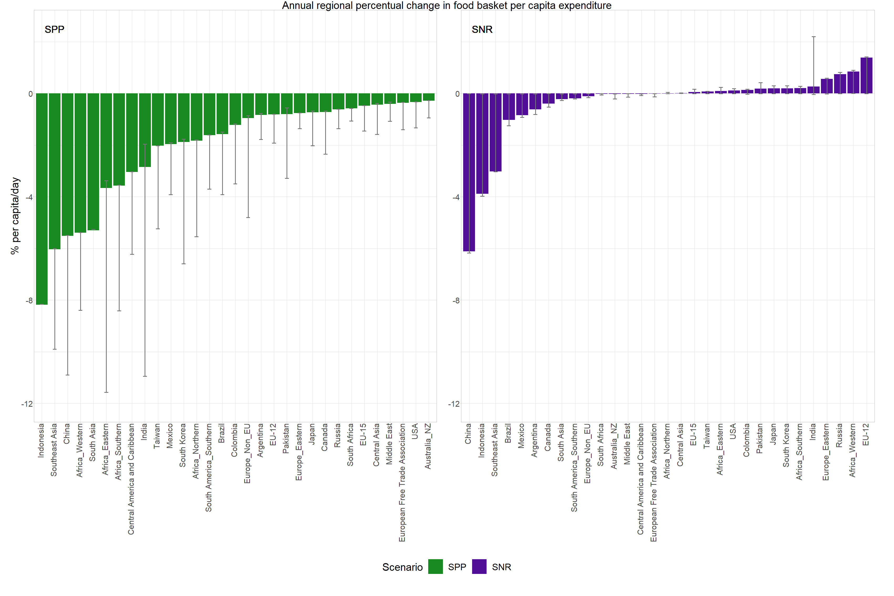
Annual food expenditure per capita
SPP will reduce the food expenditure everywhere
SNR will have some drawbacks into some economies due to the trade dynamics, but still it will globally benefit them
Fig: food expenditure by capita daily
Notes:
China, Indonesia, SourtheastAsia → en REF no consumien gaire rumiants, llavors bàsicament augmentes monogàstrics que ja els hi era una opció económica
EU-12, Russia, Europe_Eastern → en REF consumien molts rumiants i a més a més generaven poques proteïnes noR. El canvi de dieta té més impact i els obliga a produir o a importar aliments que abans no consumien en grans quantitats
AfricaW → en REF era molt plant protein based. L’increment de monogàstrics fa que pugi el preu final

Slide 34
Next steps

Slide 35
Next steps
Explore the effects of climate mitigation:
How does the dietary shifts reduce total mitigation cost to achieve the targets defined in the Paris Agreement (2ºC and 1.5ºC)?

Slide 36
Next steps
Explore the effects of climate mitigation:
How does the dietary shifts reduce total mitigation cost to achieve the targets defined in the Paris Agreement (2ºC and 1.5ºC)?
Scenario refinement:
Consider only the scenarios that meet the minimum nutritional requirements in terms of Kcal, macronutrients & micronutrients intake

Slide 37
Next steps
Explore the effects of climate mitigation:
How does the dietary shifts reduce total mitigation cost to achieve the targets defined in the Paris Agreement (2ºC and 1.5ºC)?
Scenario refinement:
Consider only the scenarios that meet the minimum nutritional requirements in terms of Kcal, macronutrients & micronutrients intake
Run more scenarios to have a better overview of the possible more extreme dynamics

Slide 38
Next steps
Explore the effects of climate mitigation:
How does the dietary shifts reduce total mitigation cost to achieve the targets defined in the Paris Agreement (2ºC and 1.5ºC)?
Scenario refinement:
Consider only the scenarios that meet the minimum nutritional requirements in terms of Kcal, macronutrients & micronutrients intake
Run more scenarios to have a better overview of the possible more extreme dynamics
Consider scenarios where only some regions expirence a dietary shift, whereas others remain constant

Slide 39
Next steps
Explore the effects of climate mitigation:
How does the dietary shifts reduce total mitigation cost to achieve the targets defined in the Paris Agreement (2ºC and 1.5ºC)?
Scenario refinement:
Consider only the scenarios that meet the minimum nutritional requirements in terms of Kcal, macronutrients & micronutrients intake
Run more scenarios to have a better overview of the possible more extreme dynamics
Consider scenarios where only some regions expirence a dietary shift, whereas others remain constant
Consider multiple consumers

Slide 40



Clàudia Rodés Bachs
claudia.rodes@bc3research.org
#iam-compact
iam_compact
iam-compact
iam_compact

Slide 41
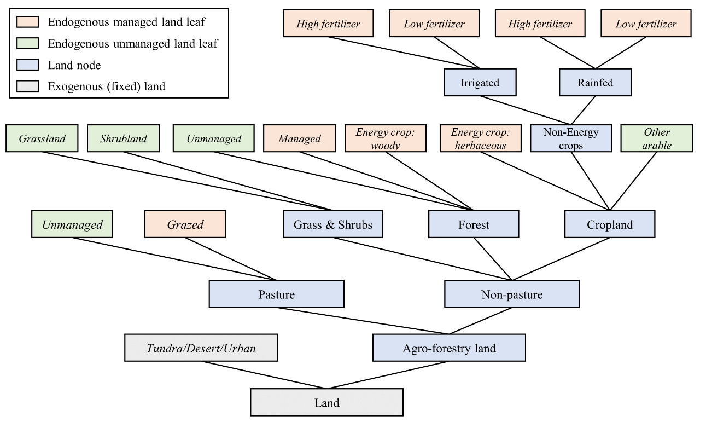
Land nesting competition
Source: https://github.com/JGCRI/gcam-doc

Slide 42
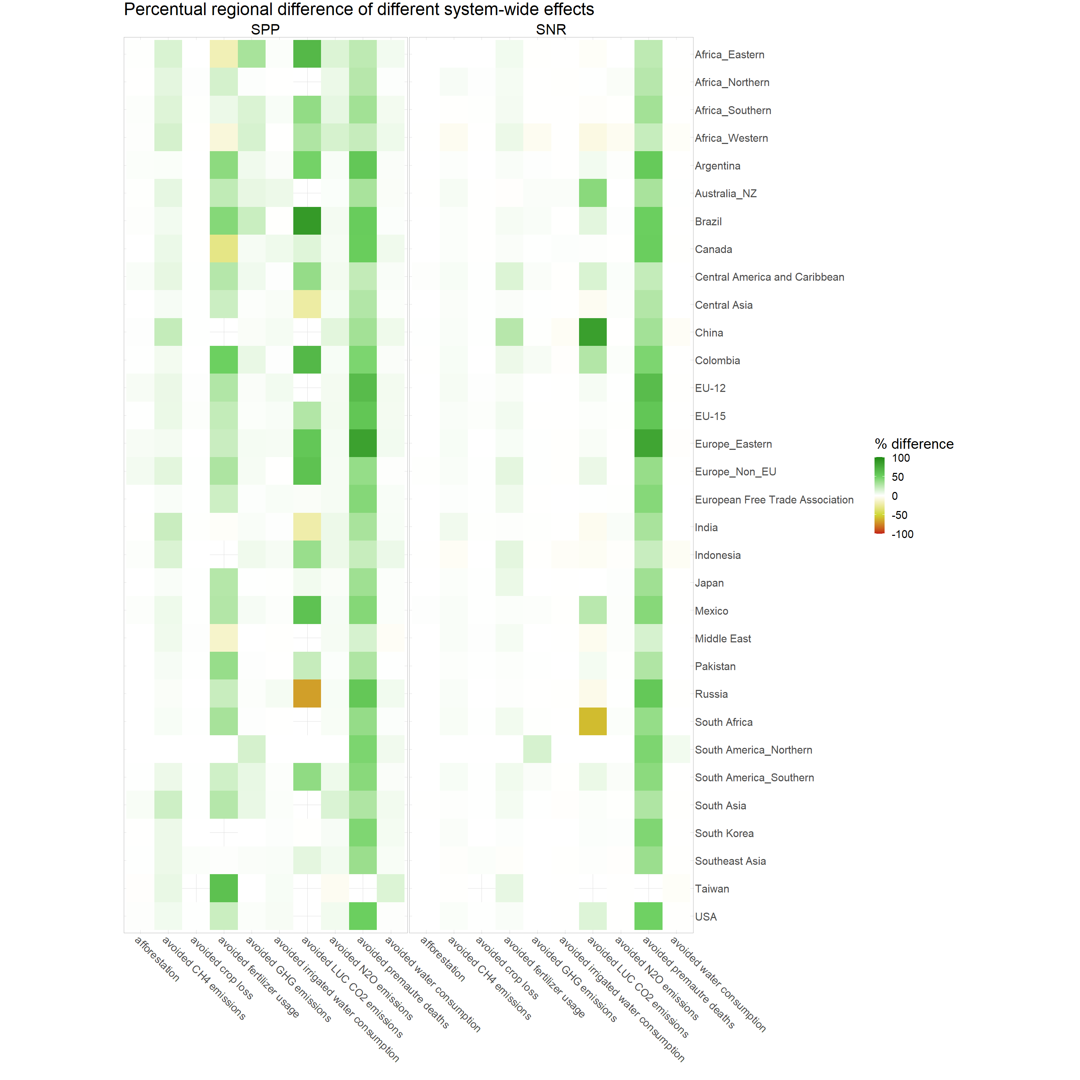
Summary

Slide 43
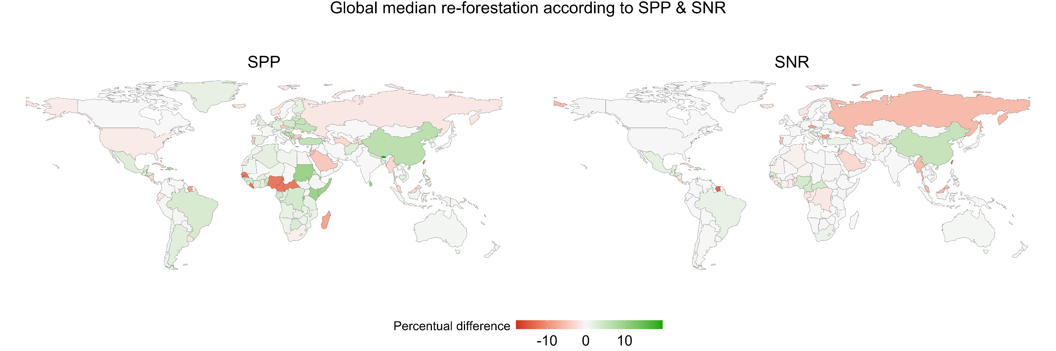
Re-forestation
Fig: re-forestation
Some regions would increase their burden when exporting Nuts and Legumes
Some regions would drastically reduce their animal protein production and would re-forest

